Slide 1
Chaos Engineering
By: Dr. Sandeep Kumar Sharma

Slide 2
My Introduction
Name : Dr. Sandeep Kr. Sharma
Total experience : 11 Years (Cloud Engineer , DevOps Engineer , Cloud Infra Engineering )
Domain – Cloud Computing (AWS, Azure, GCP) Infrastructure , DevOps
Tools Known : Git, Docker, Kubernetes , Maven, Jenkins , SonarQube, Sonar lint , Horusec , Trivy, Owasp, Anisble , Chef
Certification : AZ104, AZ305, AWS SAA-C03, Certified Site Reliability Engineering Certification
(CSREF)

Slide 3
Chaos Engineering

Slide 4


Chaos Engineering
Breaking things on Purpose

Slide 5




Chaos Engineering
Chaos Engineering is a proactive approach to test system robustness by intentionally introducing disruptions, thereby identifying and addressing weaknesses before they impact a live environment.
The aim is to identify and address weaknesses in the system before they become a problem in a live, production environment. By intentionally breaking things on a regular basis, you can ensure that your system is robust enough to handle failures without impacting user experience or causing downtime.

Slide 6
Why Chaos Engineering
Chaos engineering is a discipline within software engineering that focuses on proactively introducing controlled and measured chaos into a system to identify weaknesses and vulnerabilities before they can cause significant issues in a real-world, uncontrolled scenario. Here are some reasons why chaos engineering is embraced in the software industry:
Identifying Weaknesses
Resilience Testing
Preventing Outages
Continuous Improvement
Cultural Shift
Real-world Simulation
Improved Incident Response
Enhanced Confidence
Cost Savings
Adaptability to Scale

Slide 7
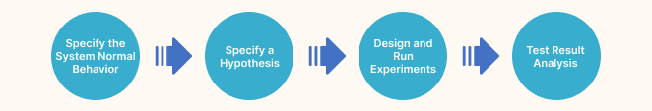
Chaos Engineering Principles

Slide 8
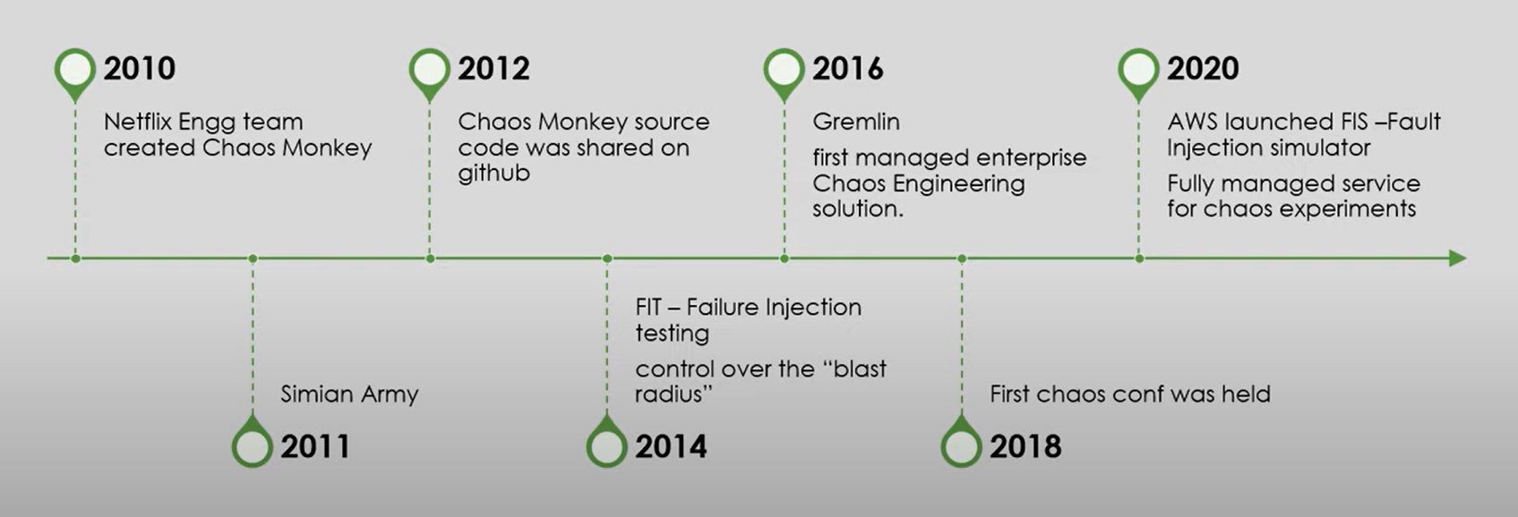
History of Chaos Engineering

Slide 9
Difference between Chaos and Regular Testing
Chaos testing differs from standard testing in numerous ways.
Chaos tests take into account the various touchpoints that are beyond the scope of testing, whereas normal testing only considers the ones that are within the scope of the testing.
Regular testing typically occurs during the project's build/compile phase, whereas chaotic testing occurs once the system is complete.
Unlike chaotic testing, regular testing does not usually include the testing of varying configurations, behaviors, outages, and other interruptions caused by a third-party entity.
Standard testing only sometimes identifies the easy fix of end-user negative reactions. It results in a disabled system that you need to fix before testing can resume. On the other hand, chaos testing introduces issues into the system to see how it reacts.
Regular testing uncovers bugs, and a blocker can cause a system hang. Chaotic testing has a predetermined abort plan that allows errors if the expected reactions are incorrect.

Slide 10
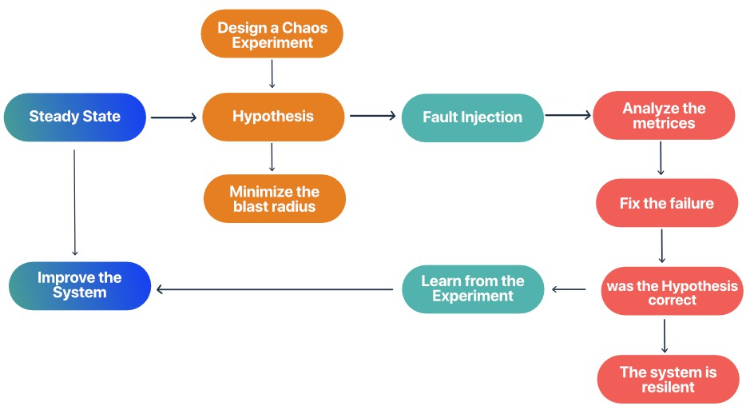
Chaos Engineering – How does it Work?
Dependency testing
check hidden dependencies between microservices, redis, database, memcached, and downstream services
Inject failure
discover weaknesses or vulnerable components of the software, and build something to keep the software running when a particular component malfunctions
Automate faults
checking the reliability of the system, engineers use site reliability engineering to try and fix faults automatically

Slide 11
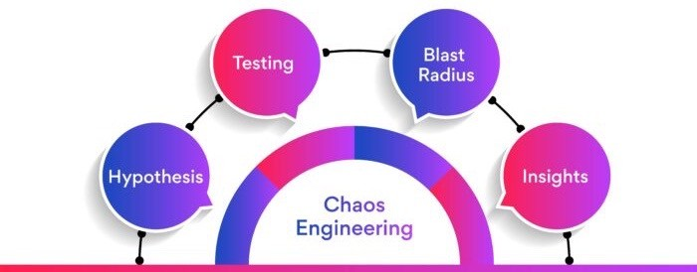
Chaos Engineering – How does it Work

Slide 12
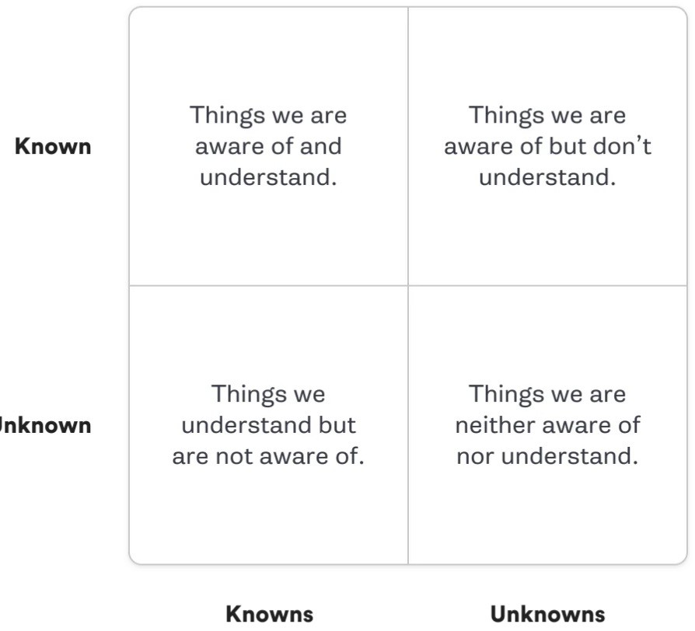
Chaos Engineering – How does it Work?
Hypothesis
The first step is the hypothesis, wherein engineers think about what can happen to the state of the application upon changing a variable. Hypothesis allows chaos engineers to ask many questions and write down their assumptions. Later, they compare these assumptions with real-life events.
Hypothesis: "If one of our database servers fails, our service will automatically switch to a backup server, and users will not experience any downtime or data loss."
This hypothesis assumes that your system is resilient enough to handle the failure of a database server by seamlessly switching to a backup server. It sets an expectation of no user impact in terms of downtime or data loss.

Slide 13
Chaos Engineering – How does it Work?
Testing
In the testing phase, chaos engineers use a simulated environment along with load testing to check the changes in services, infrastructure, network, and devices. If the results differ from the assumptions, then the chaos engineers restructure or rebuild the component.
Preparation
Implementation
Observation
Analysis
Testing: preparations include establishing monitoring and logging systems on the relevant services and servers to track performance changes. This is followed by the intentional introduction of a failure - for example, shutting down a specific database server. Observations are then made to gauge system responses, focusing on metrics such as latency, error rates, and failover timing.
Post-test, collected data is analyzed to ascertain whether the system's behavior aligned with the initial hypothesis.

Slide 14
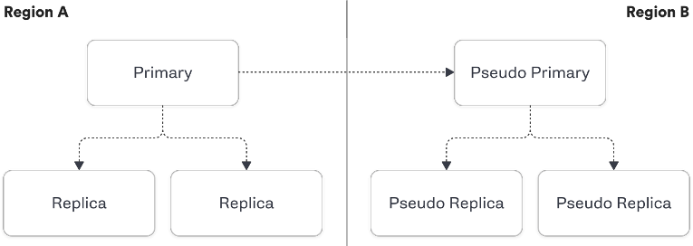
Chaos Engineering – How does it Work?
Known-Knowns
We know that when a replica shuts down it will be removed from the cluster. We know that a new replica will then be cloned from the primary and added back to the cluster.
Known-Unknowns
We know that the clone will occur, as we have logs that confirm if it succeeds or fails, but we don’t know the weekly average of the mean time it takes from experiencing a failure to adding a clone back to the cluster effectively.
We know we will get an alert that the cluster has only one replica after 5 minutes but we don’t know if our alerting threshold should be adjusted to more effectively prevent incidents.
Unknown-Knowns
If we shutdown the two replicas for a cluster at the same time, we don’t know exactly the mean time during a Monday morning it would take us to clone two new replicas off the existing primary. But we do know we have a pseudo primary and two replicas which will also have the transactions.
Unknown-Unknowns
We don’t know exactly what would happen if we shutdown an entire cluster in our main region, and we don’t know if the pseudo region would be able to failover effectively because we have not yet run this scenario.

Slide 15
Chaos Engineering – How does it Work
Blast Radius
The "blast radius" refers to the scope of impact during the testing phase in Chaos Engineering. It's a boundary defined by chaos engineers that encapsulates the anticipated damage or effects when specific variables and components are tested under stress.
the blast radius is a safeguard that prevents chaos experiments from causing widespread or uncontrolled damage.
Blast Radius: In your system, assume you have multiple database servers that are mirrored for redundancy. For the chaos experiment, you decide to shut down one database server to simulate a failure.
The "blast radius" for this experiment would be that one database server you shut down. Even though you have multiple database servers, they are outside the blast radius for this experiment and are expected to remain unaffected.

Slide 16
Chaos Engineering – How does it Work
Insights
Insights in Chaos Engineering refer to the understanding gained from the process of hypothesis formation, testing, and observing the blast radius. These insights provide chaos engineers with the information they need to identify weaknesses and vulnerabilities in the system.
Positive Insights: "Our service demonstrates resilience against database server failures, swiftly transitioning to backup servers. This confirms our failover mechanisms' effectiveness in ensuring uninterrupted user experience."
Negative Insight: "Downtime was observed during a simulated server failure, indicating a delay in backup server engagement. This reveals a need for improvement in our system's failover mechanisms."

Slide 17
ccc

Slide 18
ccc

Slide 19
ccc
Chaos testing differs from standard testing in numerous ways.

Slide 20
ccc
Chaos testing differs from standard testing in numerous ways.

Slide 21
ccc
Chaos testing differs from standard testing in numerous ways.

Slide 22
ccc
Chaos testing differs from standard testing in numerous ways.

Slide 23
ccc
Chaos testing differs from standard testing in numerous ways.

Slide 24
ccc
Chaos testing differs from standard testing in numerous ways.

Slide 25
ccc
Chaos testing differs from standard testing in numerous ways.

Slide 26
ccc
Chaos testing differs from standard testing in numerous ways.

